Slide 1
Drone
Created and presented by
Zhijing Hu
Huan Min
Sara Atzbi
Joshua Salmon
Ava Zawacki

Slide 2
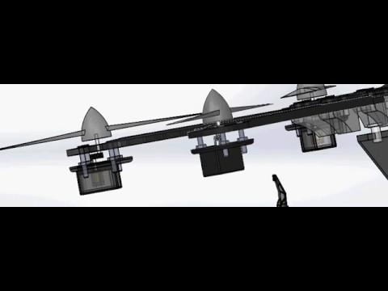
Animation Overall
(another small animation will be shown in Arm part)
Notes:
The Overview animation will go through the different perspective of the drone and roughly show how do the drone fans work as well as the piston flash bulb. The robot arm will be introduced in the following slides.

Slide 3
Overview of Tools / Components
Sketch:
Dimensions
Mates:
Gears (in fans and motor), Rack (in Robot arm)
Animation:
Explore View, Different Display Styles, Motor
Motion
Components:
Main Box, DC motor, Wings, Piston, Arm
Main Color:
Grey, Black & white

Slide 4
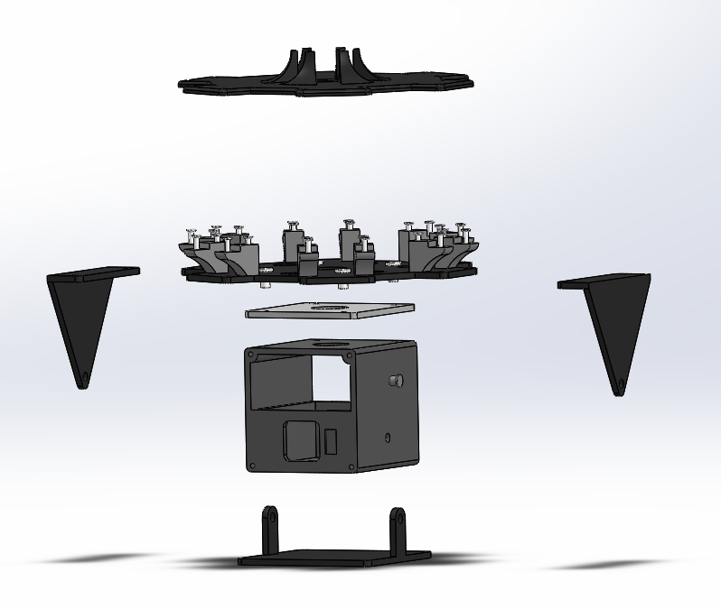
Main Body
1 Main box (contain wires etc.)
2 side connections (Protection and connection)
1 middle connection
1 bottom connection
2 wings connections (Space for connecting 6 wings)
3 proper holes for connection

Slide 5
Body-Tips and Tricks
Be aware of the thickness of every connection
Set proper extrude cut for screws and connection parts
Leave proper space for the 12 small bridges

Slide 6
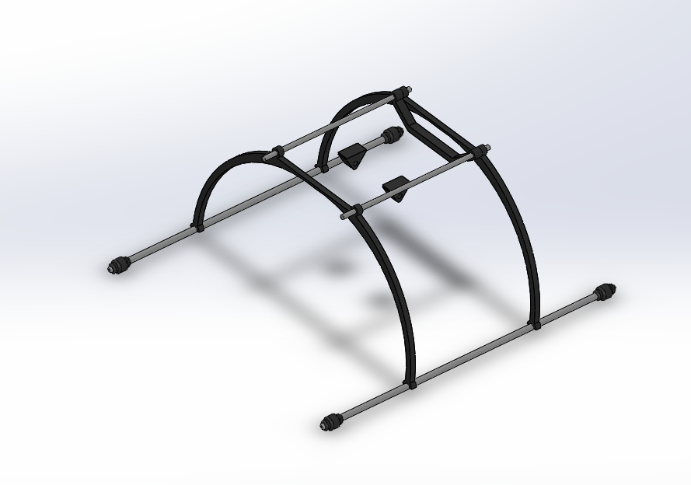
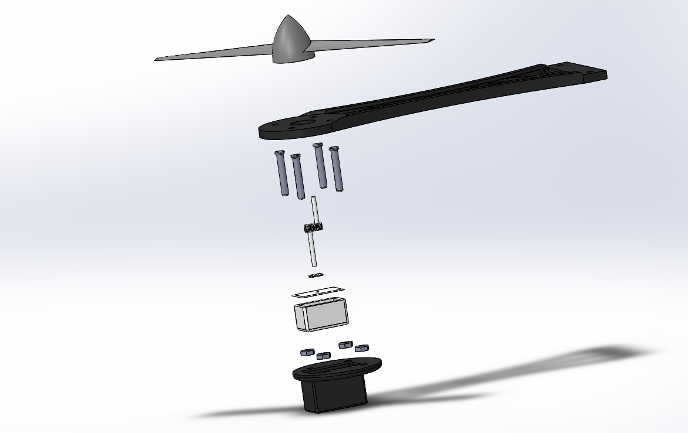
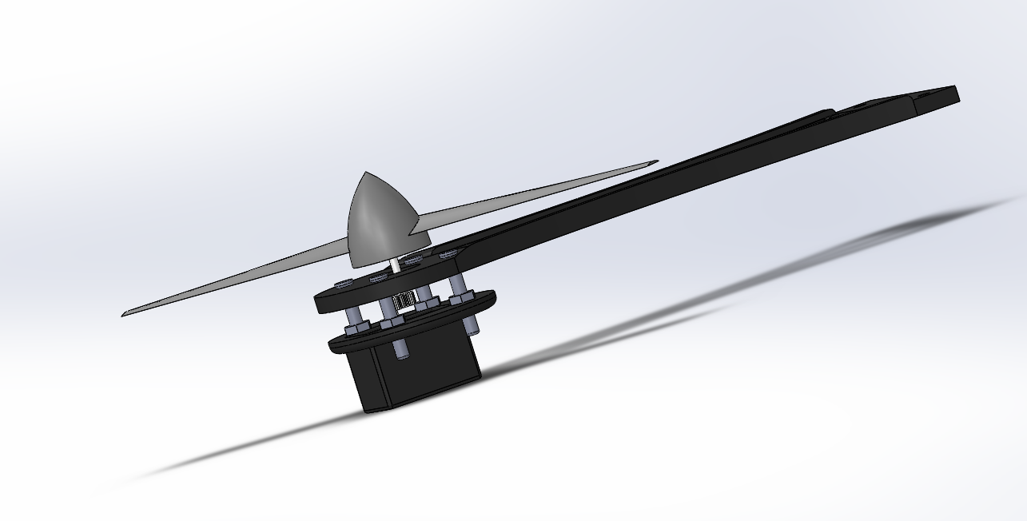
Landing Frame, Wings & Screws
Screws used for whole drone;
4 landing rods. 4 landing feet, 2 small connection (connect with main box) & 3 landing frames;
6 drone fans, 6 wing frame;
Motor shield, motor rods and gears.

Slide 7
Landing Frame, Wings & Screw Connections-Tips and Tricks
Communicate with teammates with the consistency of the screws’ dimensions;
Gear mates for the motor and fans (rods to rods, ratio 1:1000);
Proper extrude cut for wing frames (select special angles)
Use loft or sweep for the fan

Slide 8
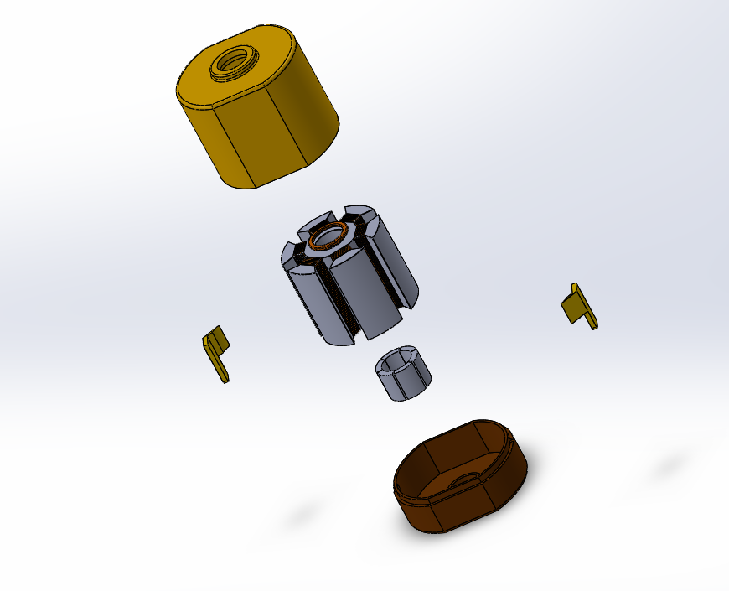
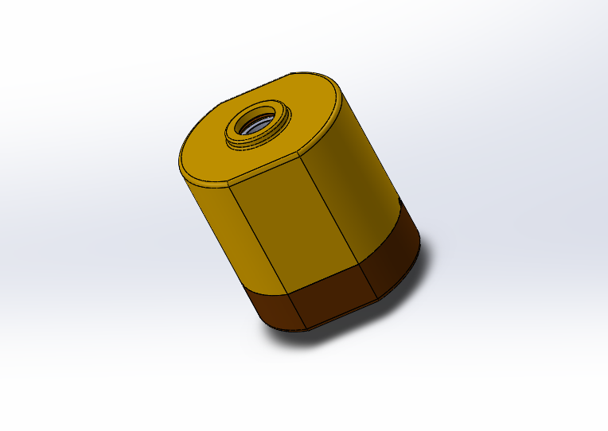
DC Motor
2 shields (top and bottom)
1 middle coil (magnet and metal wires)
1 small loop connection;
2 side small protection

Slide 9
DC Motor-Tips and Tricks
Proper size to fit into the outside shield;
Proper size to contain the rod;
Circular pattern to create the middle parts.

Slide 10
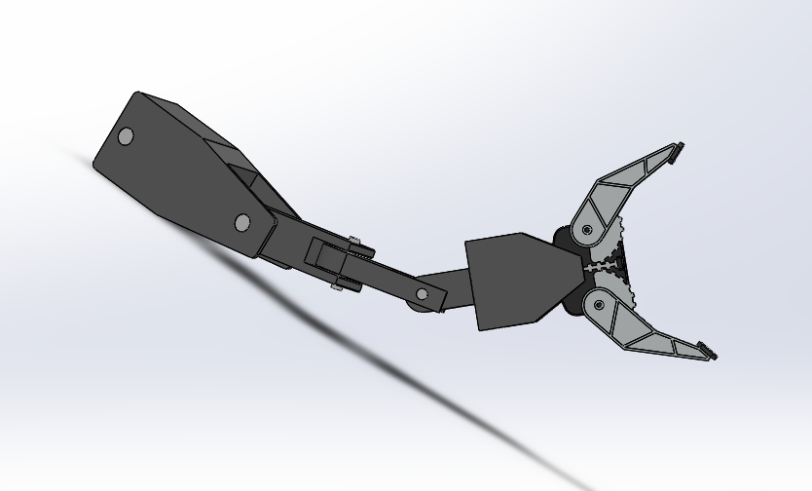
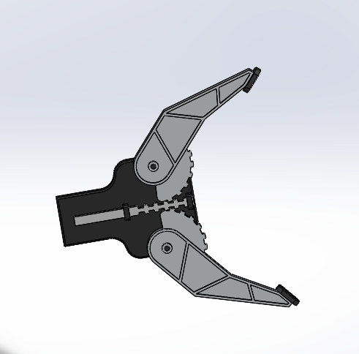
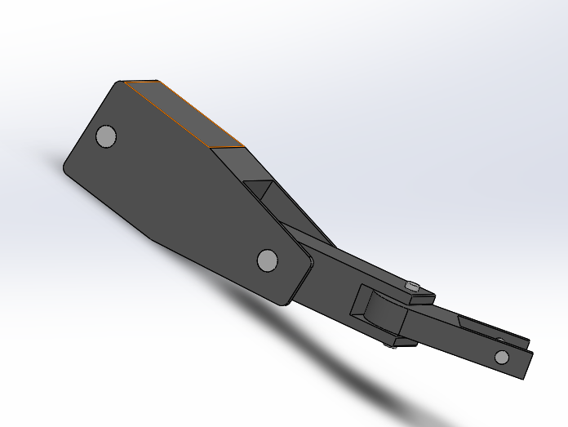
Robot Arm
Rotate (lock angle so it does not overlap)
4 connection arms
1 main hand (Rack mate)

Slide 11
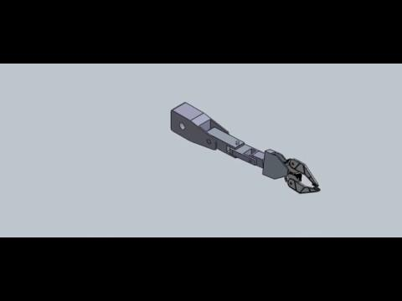
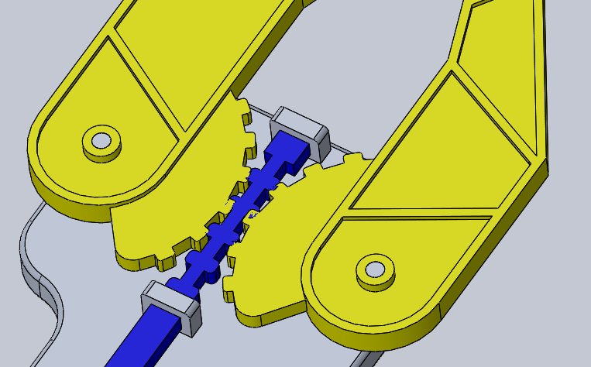
Arm-Tips and Tricks
Be aware of the dimension of each arm connection
Rack mate in the hand between rack rod and two pieces of hand

Slide 12
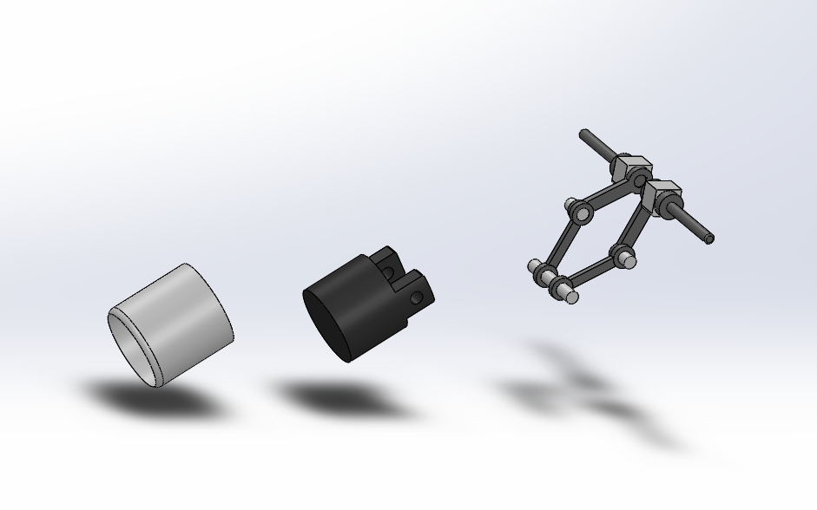
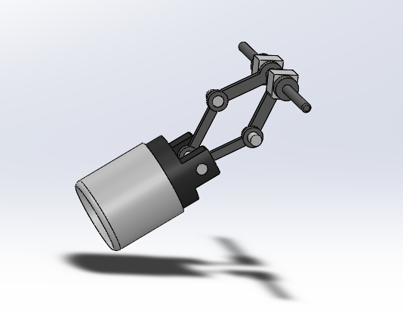
Piston
4 movable connections
2 fixed small rectangular boxes
2 main rods (connect to main box)
4 small pins.

Slide 13
Piston-Tips and Tricks
All parts must exactly fit to each other
Careful with the length of the plunger and the casing; the plunger must be shorter than the casing to allow a possible button or bulb to be inserted
Set limit mate between casing and drone, so casing stays in place
Set limit mate between casing and plunger to control how far in the plunger can go
Set the angles of the arms before creating mates, then remove set angles

Slide 14
Thank You
CAD Section 01
Group 8
May 2
2019

